Slide 1
Unit - II
SQL and PL/SQL

Slide 2
Index
SQL: Characteristics and Advantages,
SQL Data Types and Literals,
DDL, DML, DCL, TCL,
SQL Operators.
Tables: Creating, Modifying, Deleting, Updating.
SQL DML Queries:
SELECT Query and clauses, Index and Sequence in SQL.
Views: Creating, Dropping, Updating using Indexes,
Set Operations, Predicates and Joins,
Set membership, Tuple
Variables, Set comparison,
Ordering of Tuples, Aggregate Functions,
SQL Functions,
Nested Queries.
PL/SQL: Concept of Stored Procedures and Functions,
Cursors, Triggers, Assertions,
Roles and Privileges.

Slide 3
SQL: Characteristics and Advantages
Characteristics
SQL is easy to learn.
SQL is used to access data from relational database management systems.
SQL can execute queries against the database.
SQL is used to describe the data.
SQL is used to define the data in the database and manipulate it when needed.
SQL is used to create and drop the database and table.
SQL is used to create a view, stored procedure, function in a database.
SQL allows users to set permissions on tables, procedures, and views.

Slide 4
Advantages
High speed
Using the SQL queries, the user can quickly and efficiently retrieve a large amount of records from a database.
No coding needed
In the standard SQL, it is very easy to manage the database system. It doesn't require a substantial amount of code to manage the database system.
Well defined standards
Long established are used by the SQL databases that are being used by ISO and ANSI.
Portability
SQL can be used in laptop, PCs, server and even some mobile phones.
Interactive language
SQL is a domain language used to communicate with the database. It is also used to receive answers to the complex questions in seconds.
Multiple data view
Using the SQL language, the users can make different views of the database structure.

Slide 5
SQL Data Types and Literals
Data types mainly classified into three categories for every database.
String Data types
Numeric Data types
Date and time Data types

Slide 6
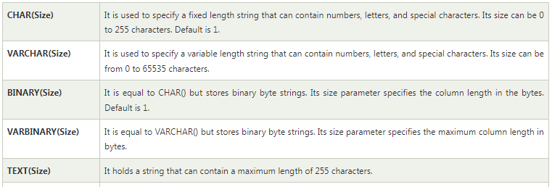
String Data types
Examples

Slide 7
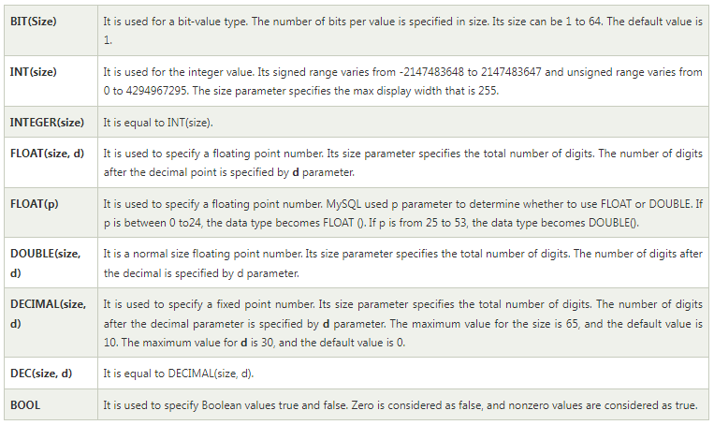
Numeric Data types

Slide 8
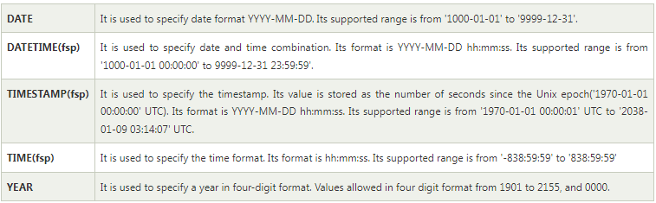
Date and time Data types

Slide 9
SQL Literals
String Literals
Numeric Literals
Date and Time Literals
Hexadecimal Literals
Bit-Value Literals
Boolean Literals
NULL Values

Slide 10
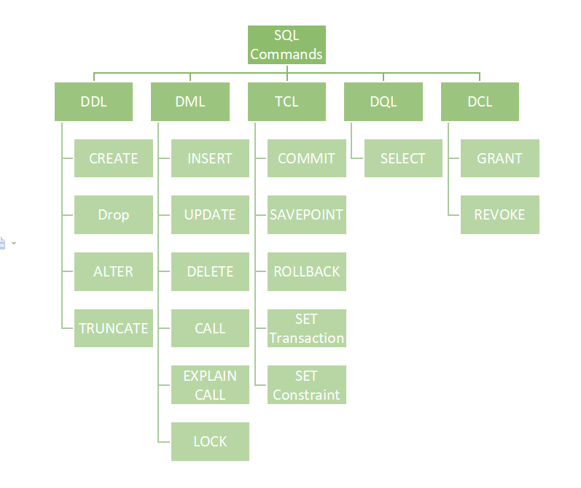
SQL Command Categories

Slide 11
Data Definition Language (DDL)
DDL or Data Definition Language actually consists of the SQL commands that can be used to define the database schema.
It simply deals with descriptions of the database schema and is used to create and modify the structure of database objects in the database.
DDL is a set of SQL commands used to create, modify, and delete database structures but not data.
These commands are normally not used by a general user, who should be accessing the database via an application.

Slide 12
List of DDL commands
CREATE: This command is used to create the database or its objects (like table, index, function, views, store procedure, and triggers).
DROP: This command is used to delete objects from the database.
ALTER: This is used to alter the structure of the database.
TRUNCATE: This is used to remove all records from a table, including all spaces allocated for the records are removed.
COMMENT: This is used to add comments to the data dictionary.
RENAME: This is used to rename an object existing in the database.

Slide 13
SQL CREATE TABLE Statement
Syntax
CREATE TABLE table_name (
column1 datatype,
column2 datatype,
column3 datatype,
....
);

Slide 14

SQL CREATE TABLE Example
CREATE TABLE Persons (
PersonID int,
LastName varchar(255),
FirstName varchar(255),
Address varchar(255),
City varchar(255)
);
The PersonID column is of type int and will hold an integer.
The LastName, FirstName, Address, and City columns are of type varchar and will hold characters, and the maximum length for these fields is 255 characters.
The empty "Persons" table will now look like this:

Slide 15
Create Table Using Another Table
Syntax
CREATE TABLE new_table_name AS
SELECT column1, column2,...
FROM existing_table_name
WHERE ....;
Example
CREATE TABLE TestTable AS
SELECT customername, contactname
FROM customers;

Slide 16
SQL DROP TABLE Statement
The DROP TABLE statement is used to drop an existing table in a database.
DROP TABLE table_name;
  SQL DROP TABLE Example-
  DROP TABLE Shippers;

Slide 17
SQL TRUNCATE TABLE
The TRUNCATE TABLE statement is used to delete the data inside a table, but not the table itself.
  Syntax:
  TRUNCATE TABLE table_name;

Slide 18
SQL ALTER TABLE Statement
The ALTER TABLE statement is used to add, delete, or modify columns in an existing table.
The ALTER TABLE statement is also used to add and drop various constraints on an existing table.

Slide 19
ALTER TABLE - ADD Column
To add a column in a table, use the following syntax:
ALTER TABLE table_name
ADD column_name datatype;
Example -
The following SQL adds an "Email" column to the "Customers" table:
ALTER TABLE Customers
ADD Email varchar(255);

Slide 20
ALTER TABLE - DROP COLUMN
To delete a column in a table, use the following syntax (notice that some database systems don't allow deleting a column):
ALTER TABLE table_name
DROP COLUMN column_name;
The following SQL deletes the "Email" column from the "Customers" table:
ALTER TABLE Customers DROP COLUMN Email;

Slide 21
ALTER TABLE - RENAME COLUMN AND
MODIFY COLUMN DATATYPE
ALTER TABLE - RENAME COLUMN
ALTER TABLE table_name
RENAME COLUMN old_name to new_name;
ALTER TABLE - ALTER/MODIFY DATATYPE
ALTER TABLE table_name
ALTER COLUMN column_name datatype;
ALTER TABLE table_name
MODIFY COLUMN column_name datatype;

Slide 22
SQL Comments
Comments are used to explain sections of SQL statements, or to prevent execution of SQL statements.
Single Line Comments
Single line comments start with --
Any text between -- and the end of the line will be ignored (will not be executed).
The following example uses a single-line comment as an explanation:
--Select all:
SELECT * FROM Customers;
The following example uses a single-line comment to ignore the end of a line:
SELECT * FROM Customers -- WHERE City='Berlin‘;

Slide 23
DQL (Data Query Language)
DQL statements are used for performing queries on the data within schema objects.
The purpose of the DQL Command is to get some schema relation based on the query passed to it.
We can define DQL as follows it is a component of SQL statement that allows getting data from the database and imposing order upon it.
It includes the SELECT statement.
This command allows getting the data out of the database to perform operations with it.
When a SELECT is fired against a table or tables the result is compiled into a further temporary table, which is displayed or perhaps received by the program i.e. a front-end.
List of DQL:
SELECT: It is used to retrieve data from the database.

Slide 24
DML (Data Manipulation Language)
The SQL commands that deal with the manipulation of data present in the database belong to DML or Data Manipulation Language and this includes most of the SQL statements. It is the component of the SQL statement that controls access to data and to the database. Basically, DCL statements are grouped with DML statements.
List of DML commands:
INSERT: It is used to insert data into a table.
UPDATE: It is used to update existing data within a table.
DELETE: It is used to delete records from a database table.
LOCK: Table control concurrency.
CALL: Call a PL/SQL or JAVA subprogram.
EXPLAIN PLAN: It describes the access path to data.

Slide 25
DML – INSERT COMMAND
INSERT INTO Syntax:
INSERT INTO table_name VALUES (value1, value2, value3);
Insert Data in Specified Columns - Syntax:
INSERT INTO table_name (column1, column2, column3) VALUES ( value1, value2, value3);

Slide 26
Method 1 (Inserting only values) – SQL INSERT Query
Method 2 (Inserting values in only specified columns) – SQL INSERT INTO Statement

Slide 27
Inserting all columns of a table – INSERT INTO SELECT Statement
We can copy all the data of a table and insert it into a different table.
Syntax:
INSERT INTO first_table SELECT * FROM second_table;

Slide 28
Inserting specific columns of a table – INSERT INTO SELECT Statement
We can copy only those columns of a table that we want to insert into a different table.
Syntax:
INSERT INTO first_table(names_of_columns1)
SELECT names_of_columns2 FROM second_table;

Slide 29
DML : UPDATE Statement
The UPDATE statement in SQL is used to update the data of an existing table in the database.
We can update single columns as well as multiple columns using the UPDATE statement as per our requirement.
Syntax
UPDATE table_name SET column1 = value1, column2 = value2,… WHERE condition;

Slide 30
Updating Multiple Columns
Example
UPDATE Customer SET CustomerName = 'Satyam', Country = 'USA' WHERE CustomerID = 1;

Slide 31
Omitting WHERE Clause
If we omit the WHERE clause from the update query then all of the rows will get updated.
Example:
UPDATE Customer SET CustomerName = 'Shubham';

Slide 32
DML : DELETE Command
Existing records in a table can be deleted using the SQL DELETE Statement.
We can delete a single record or multiple records depending on the condition we specify in the WHERE clause.
Syntax:
DELETE FROM table_name WHERE some_condition;

Slide 33
Deleting Single Record
Example
Delete the rows where NAME = ‘Rithvik’. This will delete only the fourth row.
Query:
DELETE FROM EMPLOYEE WHERE NAME = 'Rithvik';

Slide 34
Deleting Multiple Records
Delete the rows from the table Employee where the department is “Development”. This will delete 2 rows(the first row and the seventh row).
Query:
DELETE FROM Employee WHERE department = 'Development';

Slide 35
Delete All of the Records
There are two queries to do this as shown below,
Query:
DELETE FROM Employee;
Or
DELETE * FROM Employee;
Output:
All of the records in the table will be deleted, there are no records left to display. The table Employee will become empty!
NOTE : DELETE is a DML (Data Manipulation Language) command hence operation performed by DELETE can be rolled back or undone.

Slide 36
DML : LOCK Command
SQL Server is a versatile database and it is the most used Relational Database that is used across many software industries. In this article, let us see about the SQL Lock table in SQL Server by taking some practical examples. As it is meeting Atomicity(A), Consistency(C), Isolation(I), and Durability(D) requirements it is called a relational database. In order to maintain ACID mechanisms, in SQL Server, a lock is maintained.

Slide 37
There are different types of locks are there.
Shared (S) Locks: When the object needs to be read, this type of lock will occur, but this is not harmful.
Exclusive (X) Locks: It prevents other transactions like inserting/updating/deleting etc., Hence no modifications can be done on a locked object.
Update (U) Locks: More or less similar to Exclusive lock but here the operation can be viewed as “read phase” and “write phase”. Especially during the read phase, other transactions are prevented.
Intent Locks: When SQL Server has the shared (S) lock or exclusive (X) lock on a row, then the intent lock is on the table.
Regular intent locks: Intent exclusive (IX) , Intent shared (IS), and Intent update (IU).
Conversion locks: Shared with intent exclusive (SIX), Shared with intent update (SIU), and Update with intent exclusive (UIX).

Slide 38
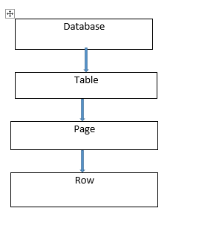
Lock hierarchy

Slide 39
CALL
A stored procedure is a pre-written SQL query that can be called multiple times and will run as the same.
Like we can create a Stored procedure for Insert, select, update in SQL database.
We can also pass parameters to the Stored procedures.

Slide 40
Using CALL
Step 1: Creating Database
    CREATE DATABASE GFG
Step 2: Using Database
    USE GFG
Step 3: Create a table
    CREATE TABLE gfgTutorial( id integer, Name varchar(20) )
Step 4: Describe the table
    sp_help 'dbo.gfgTutorial'
Step 5: Insert some data into the table
Step 6: Create a Stored procedure for Select all the rows from a table
    CREATE PROCEDURE select_all_data AS SELECT * FROM gfgTutorial ;
    EXEC select_all_data
Continue….

Slide 41
Parameterized Stored Procedure
Step 1: Create a parameterized stored procedure to insert data in the table
CREATE PROCEDURE insertData @Name varchar(30), @id varchar(30) AS INSERT INTO gfgTutorial VALUES(@id, @Name)
Step 2: Execute stored procedure
EXEC insertData @Name = 'Inserted Name', @id = 6
Check the data is inserted or not.
    EXEC select_all_data

Slide 42
DCL (Data Control Language)
DCL includes commands such as GRANT and REVOKE which mainly deal with the rights, permissions, and other controls of the database system.
List of DCL commands:
GRANT: This command gives users access privileges to the database.
Syntax:
GRANT SELECT, UPDATE ON MY_TABLE TO SOME_USER, ANOTHER_USER;
REVOKE: This command withdraws the user’s access privileges given by using the GRANT command.
Syntax:
REVOKE SELECT, UPDATE ON MY_TABLE FROM USER1, USER2;

Slide 43
TCL (Transaction Control Language)
Transactions group a set of tasks into a single execution unit. Each transaction begins with a specific task and ends when all the tasks in the group successfully complete. If any of the tasks fail, the transaction fails.
Therefore, a transaction has only two results: success or failure.
BEGIN: Opens a Transaction.
COMMIT: Commits a Transaction.
  Syntax:
  COMMIT;
ROLLBACK: Rollbacks a transaction in case of any error occurs.
  Syntax:
  ROLLBACK;
SAVEPOINT: Sets a save point within a transaction.
  Syntax:
  SAVEPOINT SAVEPOINT_NAME;

Slide 44
SQL Operators.
Types of SQL Operators
Arithmetic operator
Comparison operator
Logical operator

Slide 45
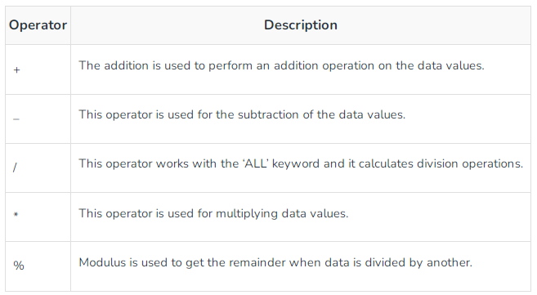
Arithmetic Operators
Example Query:
SELECT * FROM employee WHERE emp_city NOT LIKE 'A%';

Slide 46
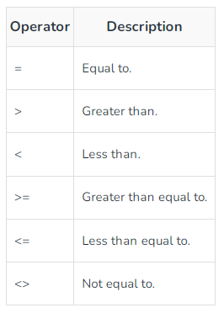
Comparison Operators
Example Query:
SELECT * FROM MATHS WHERE MARKS=50;

Slide 47
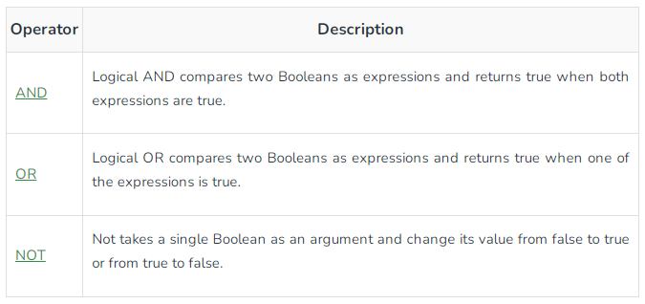
Logical Operators
Example Query:
SELECT * FROM employee WHERE emp_city = 'Allahabad' AND emp_country = 'India';

Slide 48
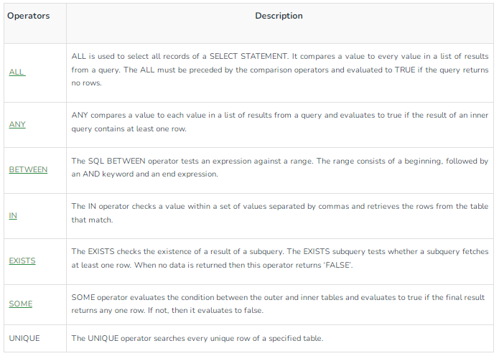
Special Operators
SELECT * FROM employee WHERE emp_id BETWEEN 101 AND 104;

Slide 49
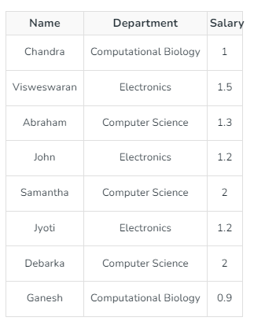
Explanation
The instructors with salary > (salary of some instructor in the ‘Computer Science’ department) get returned. The salaries in the ‘Computer Science’ department are 1.3, 2 and 2. This implies any instructor with a salary greater than 1.3 can be included in the final result.
select name from instructor where Salary > some(select Salary from instructor where dept='Computer Science');
Output:
Visweswaran
Samantha
Debarka

Slide 50
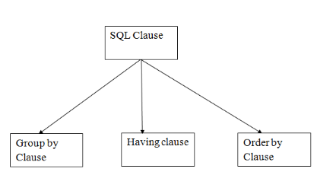
SQL Clauses

Slide 51
GROUP BY
SQL GROUP BY statement is used to arrange identical data into groups.
The GROUP BY statement is used with the SQL SELECT statement.
The GROUP BY statement follows the WHERE clause in a SELECT statement and precedes the ORDER BY clause.
The GROUP BY statement is used with aggregation function.
Syntax
  SELECT column
  FROM table_name
  WHERE conditions
  GROUP BY column
  ORDER BY column

Slide 52
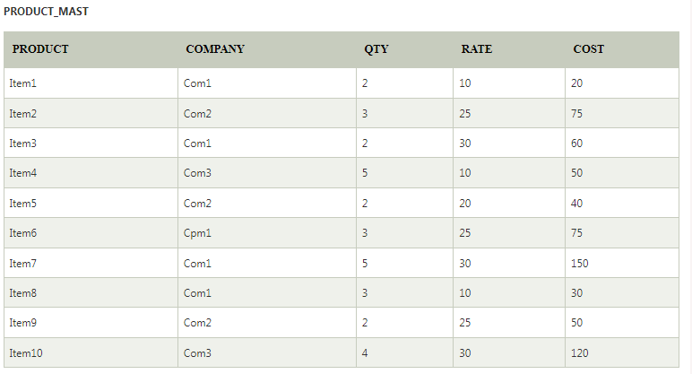
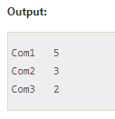
GROUP BY EXAMPLE
SELECT COMPANY, COUNT(*) FROM PRODUCT_MAST GROUP BY COMPANY;

Slide 53
HAVING
HAVING clause is used to specify a search condition for a group or an aggregate.
Having is used in a GROUP BY clause. If you are not using GROUP BY clause then you can use HAVING function like a WHERE clause.
Syntax:
SELECT column1, column2
FROM table_name
WHERE conditions
GROUP BY column1, column2
HAVING conditions
ORDER BY column1, column2;

Slide 54
HAVING EXAMPLE
SELECT COMPANY, COUNT(*) FROM PRODUCT_MAST GROUP BY COMPANY HAVING COUNT(*)>2;
Output:
Com1 5
Com2 3

Slide 55
ORDER BY
The ORDER BY clause sorts the result-set in ascending or descending order.
It sorts the records in ascending order by default. DESC keyword is used to sort the records in descending order.
Syntax:
SELECT column1, column2
FROM table_name
WHERE condition
ORDER BY column1, column2... ASC|DESC;
Where
ASC: It is used to sort the result set in ascending order by expression.
DESC: It sorts the result set in descending order by expression.

Slide 56
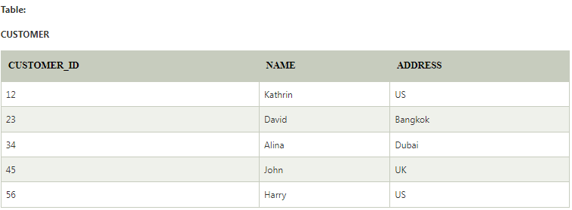
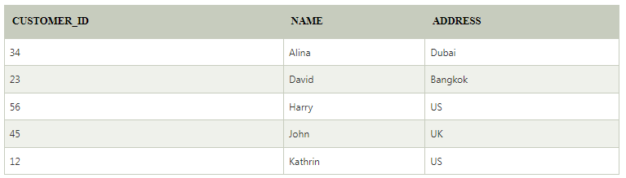
Example: Sorting Results in Ascending Order
SELECT * FROM CUSTOMER ORDER BY NAME;
Output:

Slide 57
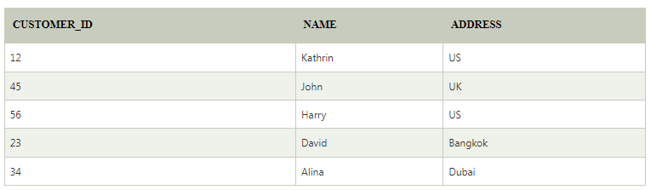
Sorting Results in Descending Order
SELECT * FROM CUSTOMER ORDER BY NAME DESC;
Output:

Slide 58
Index in SQL
Indexes are special lookup tables that the database search engine can use to speed up data retrieval.
An index helps to speed up SELECT queries and WHERE clauses, but it slows down data input, with the UPDATE and the INSERT statements. Indexes can be created or dropped with no effect on the data.
Creating an index involves the CREATE INDEX statement, which allows you to name the index, to specify the table and which column or columns to index, and to indicate whether the index is in an ascending or descending order.
Indexes can also be unique, like the UNIQUE constraint, in that the index prevents duplicate entries in the column or combination of columns on which there is an index.

Slide 59
The CREATE INDEX Command
The basic syntax of a CREATE INDEX is as follows.
CREATE INDEX index_name ON table_name;

Slide 60
Single-Column Indexes
A single-column index is created based on only one table column.
The basic syntax is as follows.
CREATE INDEX index_name ON table_name (column_name);
Unique Indexes
Unique indexes are used not only for performance, but also for data integrity.
A unique index does not allow any duplicate values to be inserted into the table.
The basic syntax is as follows.
CREATE UNIQUE INDEX index_name on table_name (column_name);
Composite Indexes
A composite index is an index on two or more columns of a table. Its basic syntax is as follows.
CREATE INDEX index_name on table_name (column1, column2);

Slide 61
The DROP INDEX Command
An index can be dropped using SQL DROP command. Care should be taken when dropping an index because the performance may either slow down or improve.
  The basic syntax is as follows −
  DROP INDEX index_name;

Slide 62
Sequence in SQL
A sequence is a user-defined schema-bound object that generates a series of numeric values.
Sequences are frequently used in many databases because many applications require each row in a table to contain a unique value and sequences provide an easy way to generate them.
The sequence of numeric values is generated in an ascending or descending order at defined intervals and can be configured to restart when it exceeds max_value.

Slide 63
Sequences
Syntax:
CREATE SEQUENCE sequence_name
START WITH initial_value
INCREMENT BY increment_value
MINVALUE minimum value
MAXVALUE maximum value
CYCLE|NOCYCLE ;
Example 1:
CREATE SEQUENCE sequence_1
start with 1
increment by 1
minvalue 0
maxvalue 100
cycle;
The above query will create a sequence named sequence_1. The sequence will start from 1 and will be incremented by 1 having maximum value of 100. The sequence will repeat itself from the start value after exceeding 100.

Slide 64
Example 2: Following is the sequence query creating a sequence in descending order.
  CREATE SEQUENCE
  sequence_2 start with 100
  increment by -1
  min value 1
  max value 100
  cycle;

Slide 65
Views in SQL
Views in SQL are considered as a virtual table. A view also contains rows and columns.
To create the view, we can select the fields from one or more tables present in the database.
A view can either have specific rows based on certain condition or all the rows of a table.

Slide 66
Advantages of View
Complexity: Views help to reduce the complexity. Different views can be created on the same base table for different users.
Security: It increases the security by excluding the sensitive information from the view.
Query Simplicity: It helps to simplify commands from the user. A view can draw data from several different tables and present it as a single table.
Consistency: A view can present a consistent, unchanged image of the structure of the database. Views can be used to rename the columns without affecting the base table.
Data Integrity: If data is accessed and entered through a view, the DBMS can automatically check the data to ensure that it meets the specified integrity constraints.
Storage Capacity: Views take very little space to store the data.
Logical Data Independence: View can make the application and database tables to a certain extent independent.

Slide 67
Disadvantages of View
The DML statements which can be performed on a view created using single base table have certain restrictions are:
You cannot INSERT if the base table has any not null column that do not appear in view.
You cannot INSERT or UPDATE if any of the column referenced in the INSERT or UPDATE contains group functions or columns defined by expression.
You can't execute INSERT, UPDATE, DELETE statements on a view if with read only option is enabled.
You can't be created view on temporary tables.
You cannot INSERT, UPDATE, DELETE if the view contains group functions GROUP BY, DISTINCT or a reference to a psuedo column rownum.
You can't pass parameters to the SQL server views.
You can't associate rules and defaults with views.

Slide 68
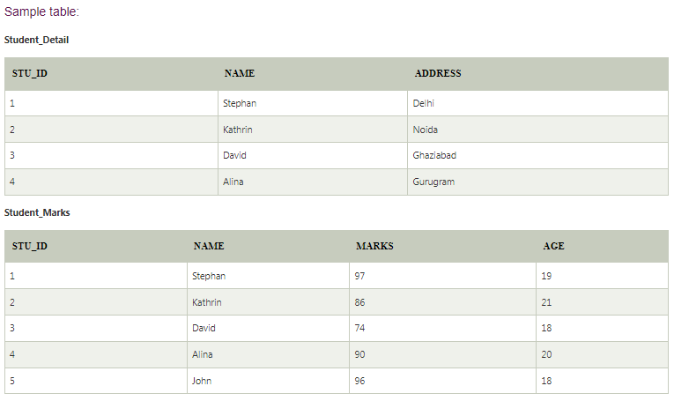
Example

Slide 69
1. Creating view
A view can be created using the CREATE VIEW statement. We can create a view from a single table or multiple tables.
Syntax:
    CREATE VIEW view_name AS
    SELECT column1, column2.....
    FROM table_name
    WHERE condition;

Slide 70
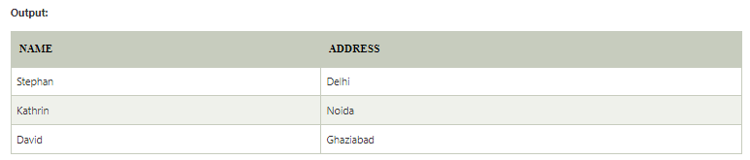
2. Creating View from a single table
In this example, we create a View named DetailsView from the table Student_Detail.
  CREATE VIEW DetailsView AS
  SELECT NAME, ADDRESS
  FROM Student_Details
  WHERE STU_ID < 4;
Just like table query, we can query the view to view the data.
  SELECT * FROM DetailsView;

Slide 71
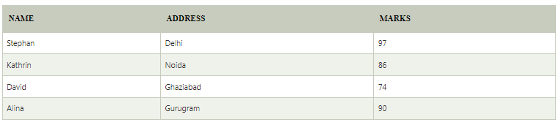
3. Creating View from multiple tables
View from multiple tables can be created by simply include multiple tables in the SELECT statement.
In the given example, a view is created named MarksView from two tables Student_Detail and Student_Marks.
  CREATE VIEW MarksView AS
  SELECT Student_Detail.NAME, Student_Detail.ADDRESS, Student_Marks.MARKS
  FROM Student_Detail, Student_Mark
  WHERE Student_Detail.NAME = Student_Marks.NAME;
To display data of View MarksView:
SELECT * FROM MarksView;

Slide 72
4. Deleting View
A view can be deleted using the Drop View statement.
Syntax
DROP VIEW view_name;
Example
  DROP VIEW MarksView;

Slide 73
Set Operations in SQL
The SQL Set operation is used to combine the two or more SQL SELECT statements.
Types of Set Operation
  Union
  UnionAll
  Intersect
  Minus

Slide 74
1. Union
The SQL Union operation is used to combine the result of two or more SQL SELECT queries.
In the union operation, all the number of datatype and columns must be same in both the tables on which UNION operation is being applied.
The union operation eliminates the duplicate rows from its resultset.
Syntax
    SELECT column_name FROM table1
    UNION
    SELECT column_name FROM table2;

Slide 75
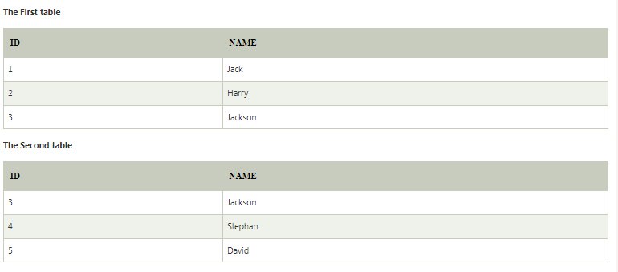
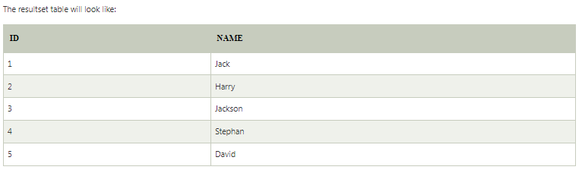
Union Example
Union SQL query will be:
SELECT * FROM First UNION SELECT * FROM Second;

Slide 76
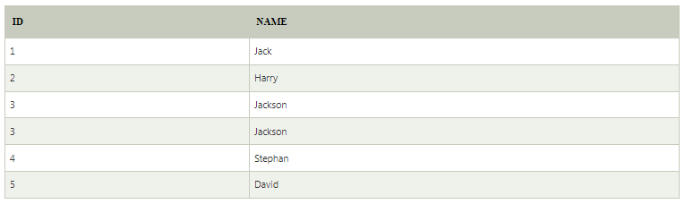
2. Union All
Union All operation is equal to the Union operation. It returns the set without removing duplication and sorting the data.
Syntax:
    SELECT column_name FROM table1
    UNION ALL
    SELECT column_name FROM table2;
Example: Using the above First and Second table.
Union All query will be like:
    SELECT * FROM First
    UNION ALL
    SELECT * FROM Second;
    The resultset table will look like:

Slide 77
3. Intersect
It is used to combine two SELECT statements. The Intersect operation returns the common rows from both the SELECT statements.
In the Intersect operation, the number of datatype and columns must be the same.
It has no duplicates and it arranges the data in ascending order by default.
Syntax
    SELECT column_name FROM table1
    INTERSECT
    SELECT column_name FROM table2;
Example:
Using the above First and Second table.
    Intersect query will be:
    SELECT * FROM First
    INTERSECT
    SELECT * FROM Second;
The resultset table will look like:

Slide 78
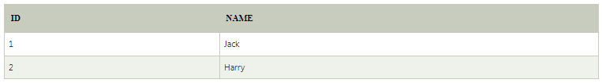
4. Minus
It combines the result of two SELECT statements. Minus operator is used to display the rows which are present in the first query but absent in the second query.
It has no duplicates and data arranged in ascending order by default.
Syntax:
    SELECT column_name FROM table1
    MINUS
    SELECT column_name FROM table2;
Example
Using the above First and Second table.
    Minus query will be:
    SELECT * FROM First
    MINUS
    SELECT * FROM Second;
The resultset table will look like:

Slide 79
SQL Joins
Different types of the JOINs in SQL:
(INNER) JOIN: Returns records that have matching values in both tables
LEFT (OUTER) JOIN: Returns all records from the left table, and the matched records from the right table
RIGHT (OUTER) JOIN: Returns all records from the right table, and the matched records from the left table
FULL (OUTER) JOIN: Returns all records when there is a match in either left or right table

Slide 80
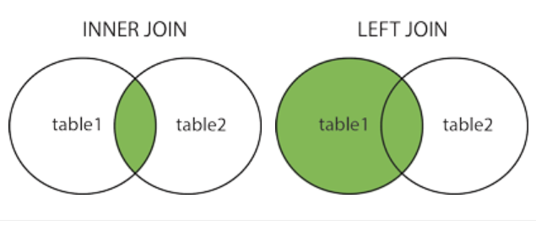
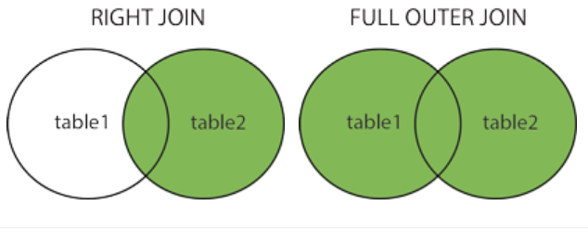

Slide 81
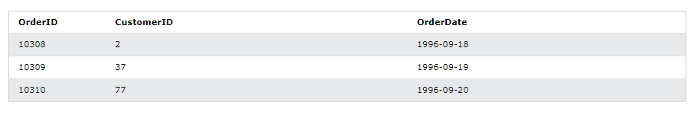
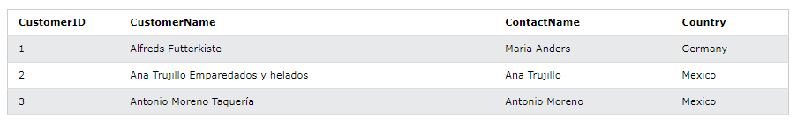
Join (Database Example)
Order Table
Customers table

Slide 82
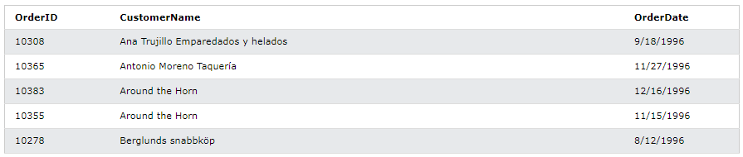
Inner Join
SELECT Orders.OrderID, Customers.CustomerName, Orders.OrderDate
FROM Orders
INNER JOIN
Customers
ON
Orders.CustomerID=Customers.CustomerID;

Slide 83
SQL | Procedures in PL/SQL
PL/SQL is a block-structured language that enables developers to combine the power of SQL with procedural statements.
A stored procedure in PL/SQL is nothing but a series of declarative SQL statements which can be stored in the database catalogue.
A procedure can be thought of as a function or a method.
They can be invoked through triggers, other procedures, or applications on Java, PHP etc.
All the statements of a block are passed to engine all at once which increases processing speed and decreases the traffic.

Slide 84
Advantages
They result in performance improvement of the application. If a procedure is being called frequently in an application in a single connection, then the compiled version of the procedure is delivered.
They reduce the traffic between the database and the application, since the lengthy statements are already fed into the database and need not be sent again and again via the application.
They add to code reusability, similar to how functions and methods work in other languages such as C/C++ and Java.

Slide 85
Disadvantages
Stored procedures can cause a lot of memory usage. The database administrator should decide an upper bound as to how many stored procedures are feasible for a particular application.
MySQL does not provide the functionality of debugging the stored procedures.

Slide 86
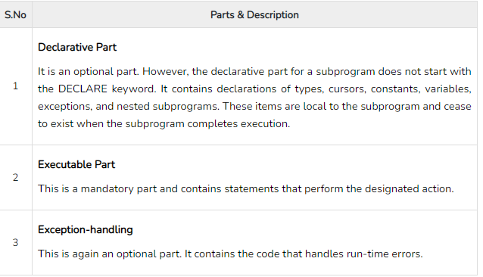
Parts of a PL/SQL Subprogram

Slide 87
Creating a Procedure
A procedure is created with the CREATE OR REPLACE PROCEDURE statement. The simplified syntax for the CREATE OR REPLACE PROCEDURE statement is as follows −
CREATE [OR REPLACE] PROCEDURE procedure_name [(parameter_name [IN | OUT | IN OUT] type [, ...])] {IS | AS} BEGIN < procedure_body > END procedure_name;
Where,
procedure-name specifies the name of the procedure.
[OR REPLACE] option allows the modification of an existing procedure.
The optional parameter list contains name, mode and types of the parameters. IN represents the value that will be passed from outside and OUT represents the parameter that will be used to return a value outside of the procedure.
procedure-body contains the executable part.
The AS keyword is used instead of the IS keyword for creating a standalone procedure.

Slide 88
Example
The following example creates a simple procedure that displays the string 'Hello World!' on the screen when executed.
CREATE OR REPLACE PROCEDURE greetings
AS
BEGIN dbms_output.put_line('Hello World!');
END; /

Slide 89
Executing a Standalone Procedure
A standalone procedure can be called in two ways −
Using the EXECUTE keyword
Calling the name of the procedure from a PL/SQL block
The above procedure named 'greetings' can be called with the EXECUTE keyword as −
EXECUTE greetings;
The above call will display −
Hello World PL/SQL procedure successfully completed.
The procedure can also be called from another PL/SQL block −
BEGIN
greetings;
END; /
The above call will display −
Hello World PL/SQL procedure successfully completed.

